Slide 1
Grammars

Slide 2

Grammars
Grammars express languages
Example: the English language

Slide 3
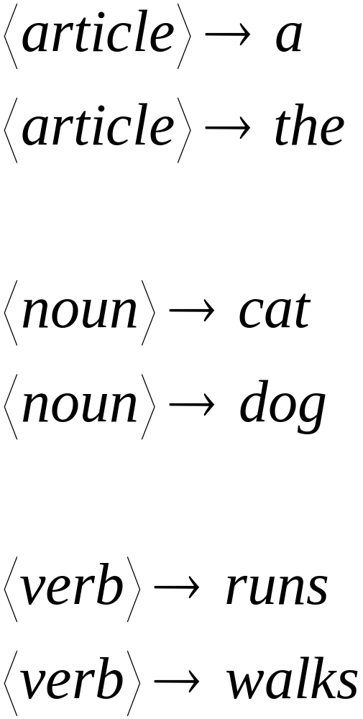

Slide 4
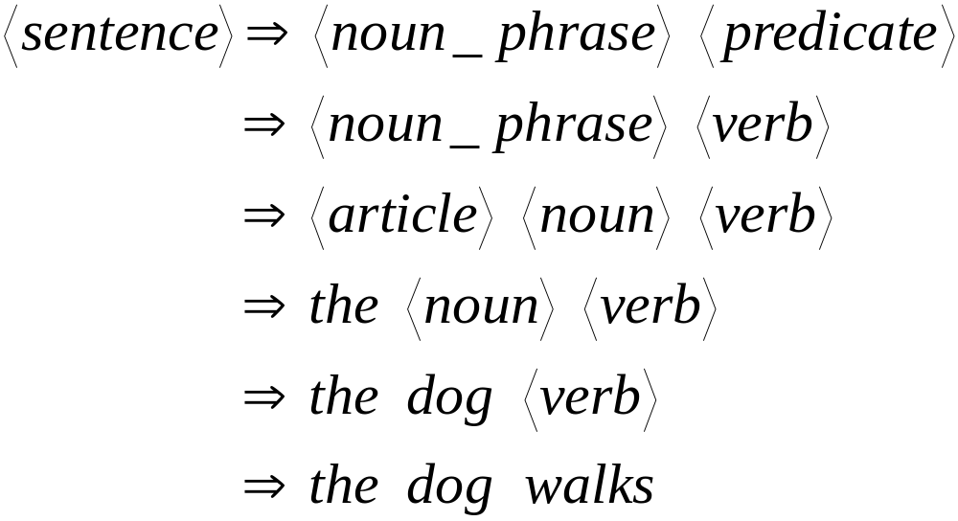
A derivation of “the dog walks”:

Slide 5
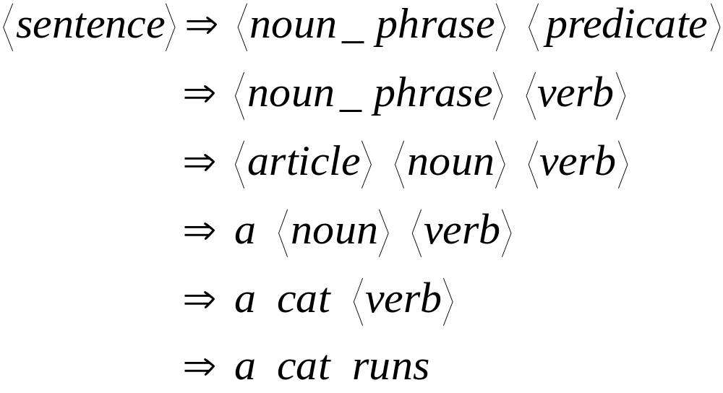
A derivation of “a cat runs”:

Slide 6
Language of the grammar:
L = { “a cat runs”,
“a cat walks”,
“the cat runs”,
“the cat walks”,
“a dog runs”,
“a dog walks”,
“the dog runs”,
“the dog walks” }

Slide 7
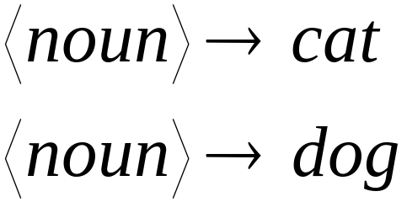
Notation
Production Rules
Variable
Terminal

Slide 8





Another Example
Grammar:
Derivation of sentence :

Slide 9



Grammar:
Derivation of sentence :

Slide 10

Other derivations:

Slide 11

Language of the grammar

Slide 12





More Notation
Grammar
Set of variables
Set of terminal symbols
Start variable
Set of Production rules

Slide 13




Example
Grammar :

Slide 14
More Notation
Sentential Form:
A sentence that contains
variables and terminals
Example:
Sentential Forms
sentence

Slide 15

We write:
Instead of:

Slide 16

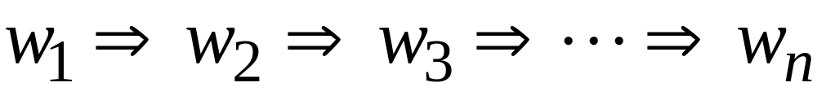
In general we write:
If:

Slide 17
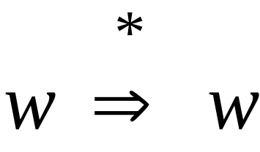
By default:

Slide 18
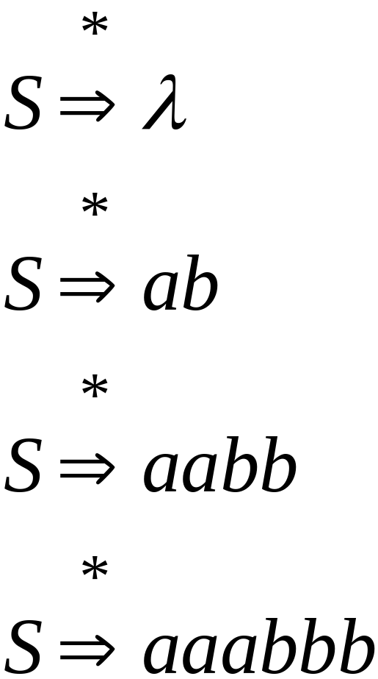
Example
Grammar
Derivations

Slide 19
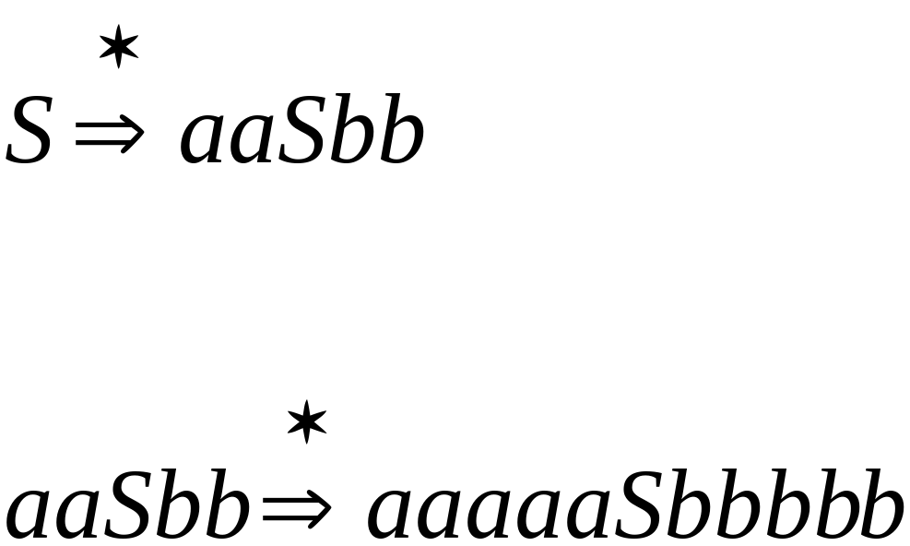
Example
Grammar
Derivations

Slide 20
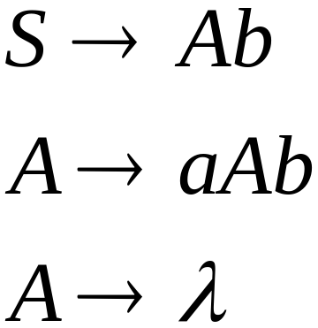
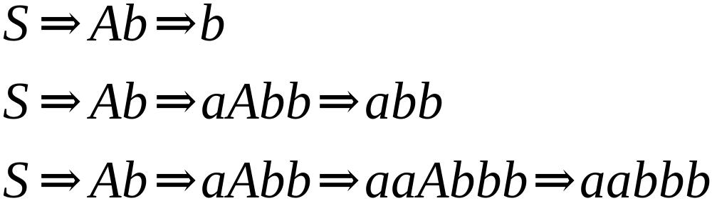
Another Grammar Example
Grammar :
Derivations:

Slide 21
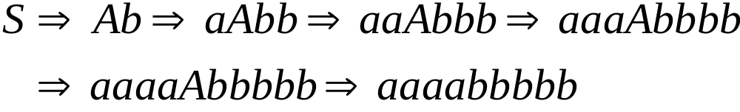
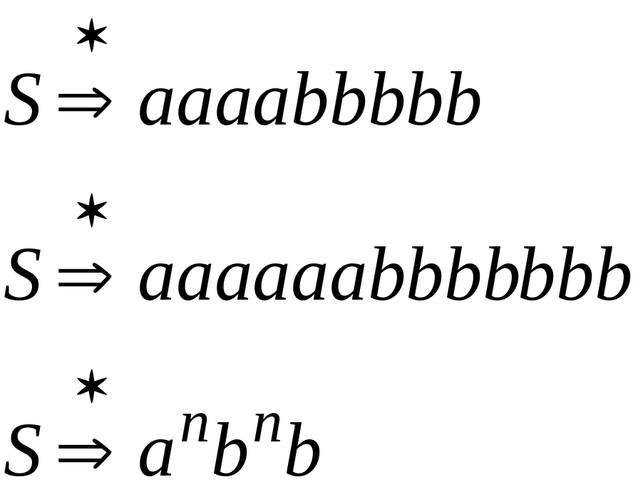
More Derivations

Slide 22

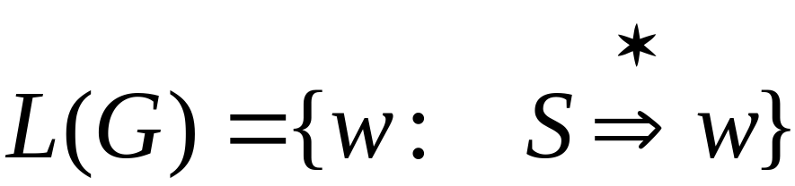
Language of a Grammar
For a grammar
with start variable :
String of terminals

Slide 23

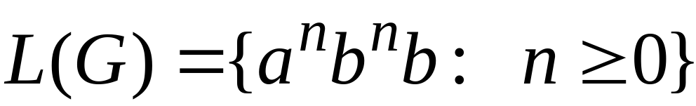
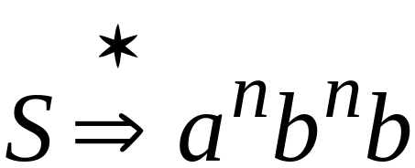
Example
For grammar :
Since:

Slide 24
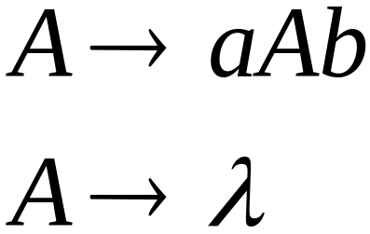
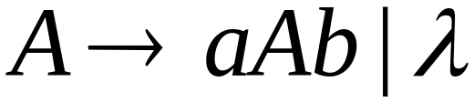
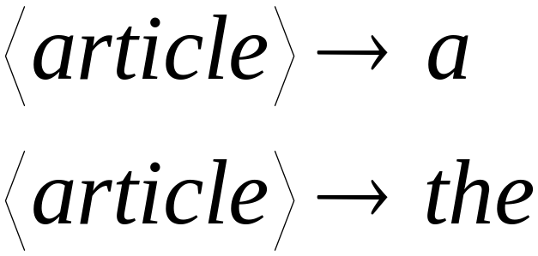
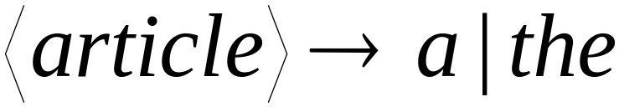
A Convenient Notation

Slide 25
Linear Grammars

Slide 26
Linear Grammars
Grammars with
at most one variable at the right side
of a production
Examples:

Slide 27
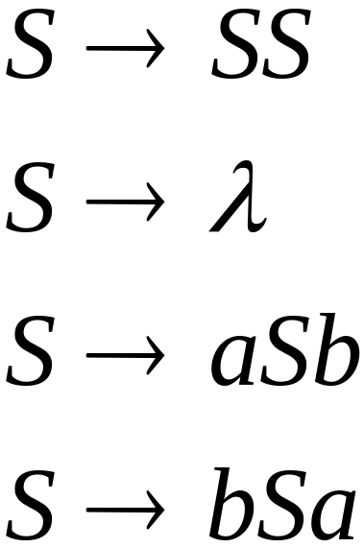
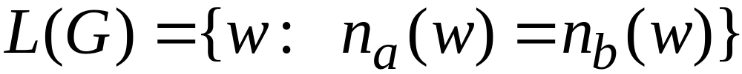


A Non-Linear Grammar
Grammar :
Number of in string

Slide 28
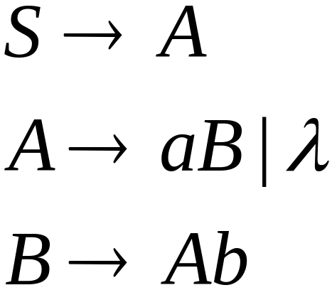
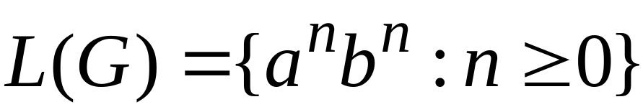
Another Linear Grammar
Grammar :

Slide 29


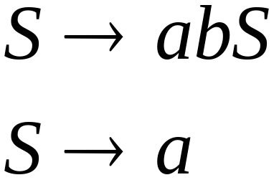
Right-Linear Grammars
All productions have form:
Example:
or
string of
terminals

Slide 30

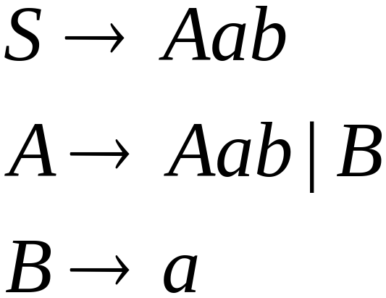
Left-Linear Grammars
All productions have form:
Example:
or
string of
terminals

Slide 31
Regular Grammars

Slide 32
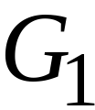
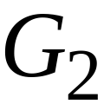
Regular Grammars
A regular grammar is any
right-linear or left-linear grammar
Examples:

Slide 33
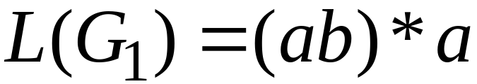
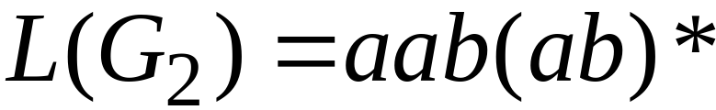
Observation
Regular grammars generate regular languages
Examples:

Slide 34
Regular Grammars
Generate
Regular Languages

Slide 35

Theorem
Languages
Generated by
Regular Grammars
Regular
Languages

Slide 36
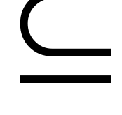
Theorem - Part 1
Languages
Generated by
Regular Grammars
Regular
Languages
Any regular grammar generates
a regular language

Slide 37

Theorem - Part 2
Languages
Generated by
Regular Grammars
Regular
Languages
Any regular language is generated
by a regular grammar

Slide 38
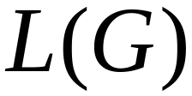
Proof – Part 1
Languages
Generated by
Regular Grammars
Regular
Languages
The language generated by
any regular grammar is regular

Slide 39

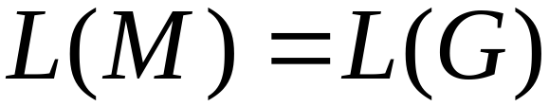
The case of Right-Linear Grammars
Let be a right-linear grammar
We will prove: is regular
Proof idea: We will construct NFA
with

Slide 40
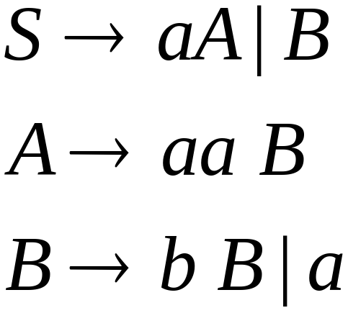
Grammar is right-linear
Example:

Slide 41



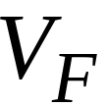

Construct NFA such that
every state is a grammar variable:
special
final state

Slide 42


Add edges for each production:

Slide 43

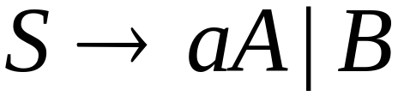

Slide 44
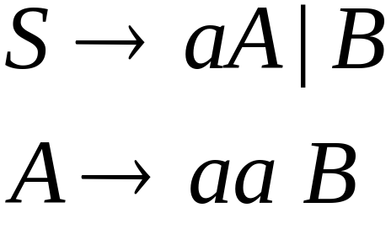

Slide 45
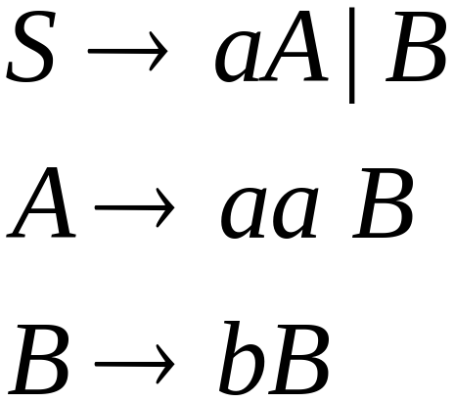


Slide 46
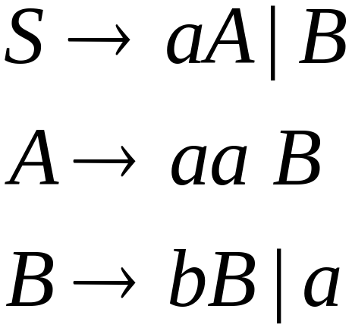

Slide 48
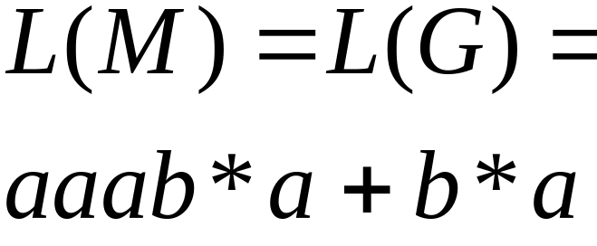
NFA
Grammar

Slide 49
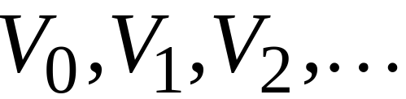
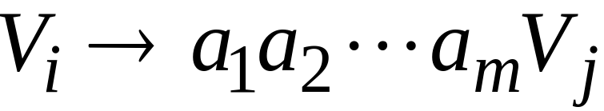
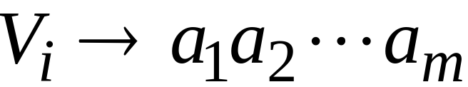
In General
A right-linear grammar
has variables:
and productions:
or

Slide 50






We construct the NFA such that:
each variable corresponds to a node:
special
final state

Slide 51


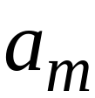


For each production:
we add transitions and intermediate nodes
………

Slide 52
For each production:
we add transitions and intermediate nodes
………

Slide 53







Resulting NFA looks like this:
It holds that:

Slide 54
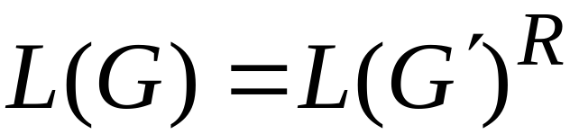

The case of Left-Linear Grammars
Let be a left-linear grammar
We will prove: is regular
Proof idea:
We will construct a right-linear
grammar with

Slide 55
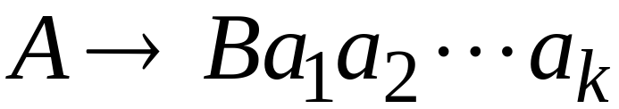
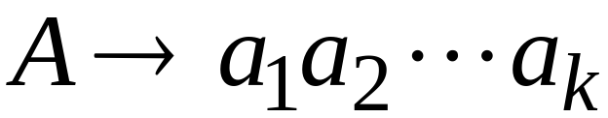
Since is left-linear grammar
the productions look like:

Slide 56

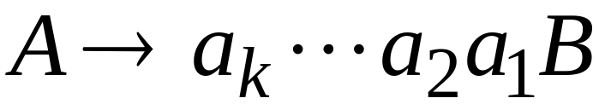
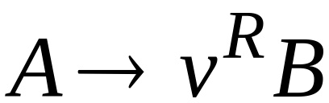
Construct right-linear grammar
Left
linear
Right
linear

Slide 57

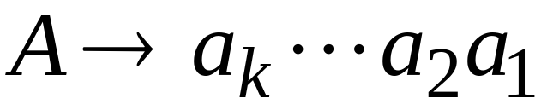
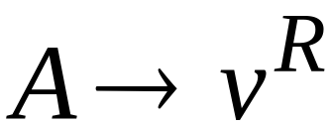
Construct right-linear grammar
Left
linear
Right
linear

Slide 58


It is easy to see that:
Since is right-linear, we have:
Regular
Language
Regular
Language
Regular
Language

Slide 59

Proof - Part 2
Languages
Generated by
Regular Grammars
Regular
Languages
Any regular language is generated
by some regular grammar

Slide 60

Any regular language is generated
by some regular grammar
Proof idea:
Let be the NFA with .
Construct from a regular grammar
such that

Slide 61





Since is regular
there is an NFA such that
Example:

Slide 62




Convert to a right-linear grammar

Slide 63


Slide 64


Slide 65



Slide 66



In General
For any transition:
Add production:
variable
terminal
variable

Slide 67


For any final state:
Add production:

Slide 68
Since is right-linear grammar
is also a regular grammar
with

